Slide 1
Processamento digital de imagens
(Montagem - no Photoshop)
Digital image processing
(Montage - in Photoshop.)
Cláudia Santos
2014

Slide 2
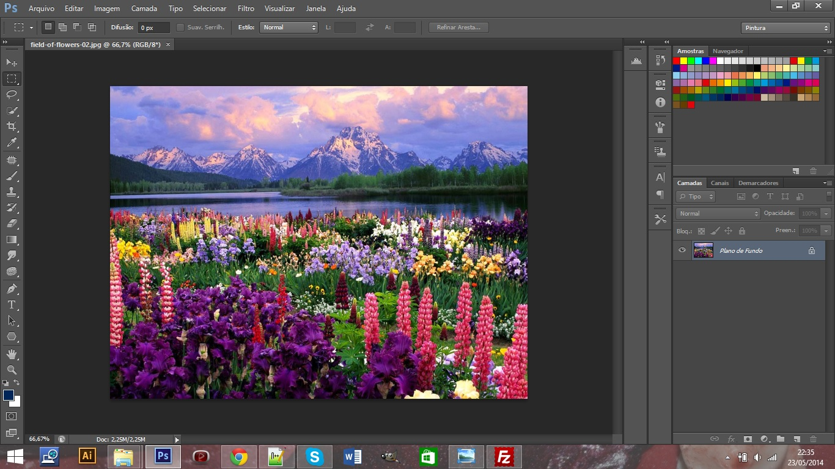
Fonte/source: http://img2.wikia.nocookie.net/__cb20090725015035/kuroshitsuji/images/5/57/Ciel's_right_eye.png

Slide 3
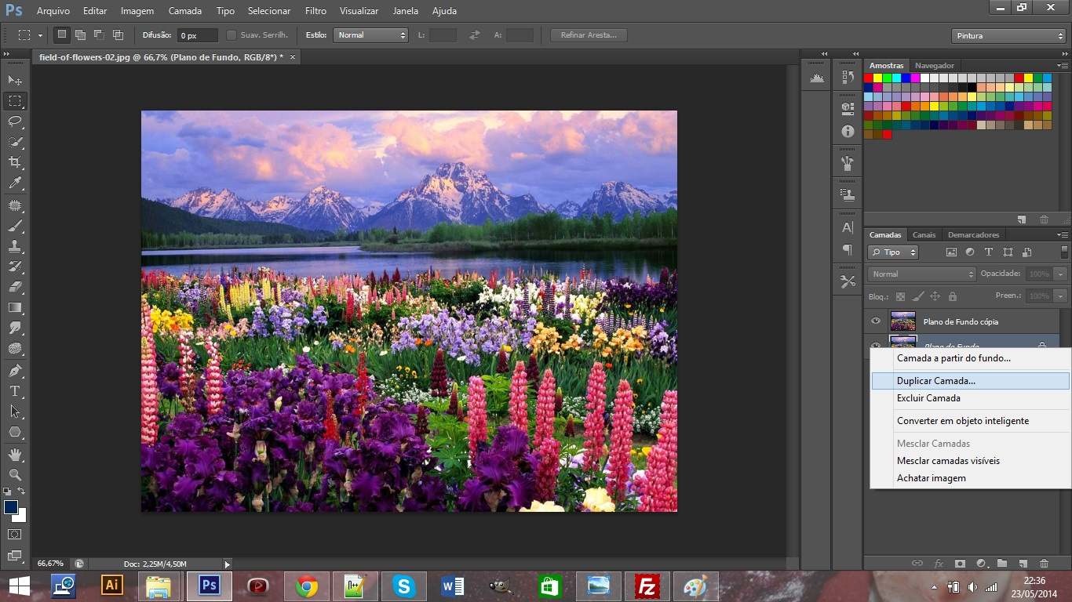

Slide 4
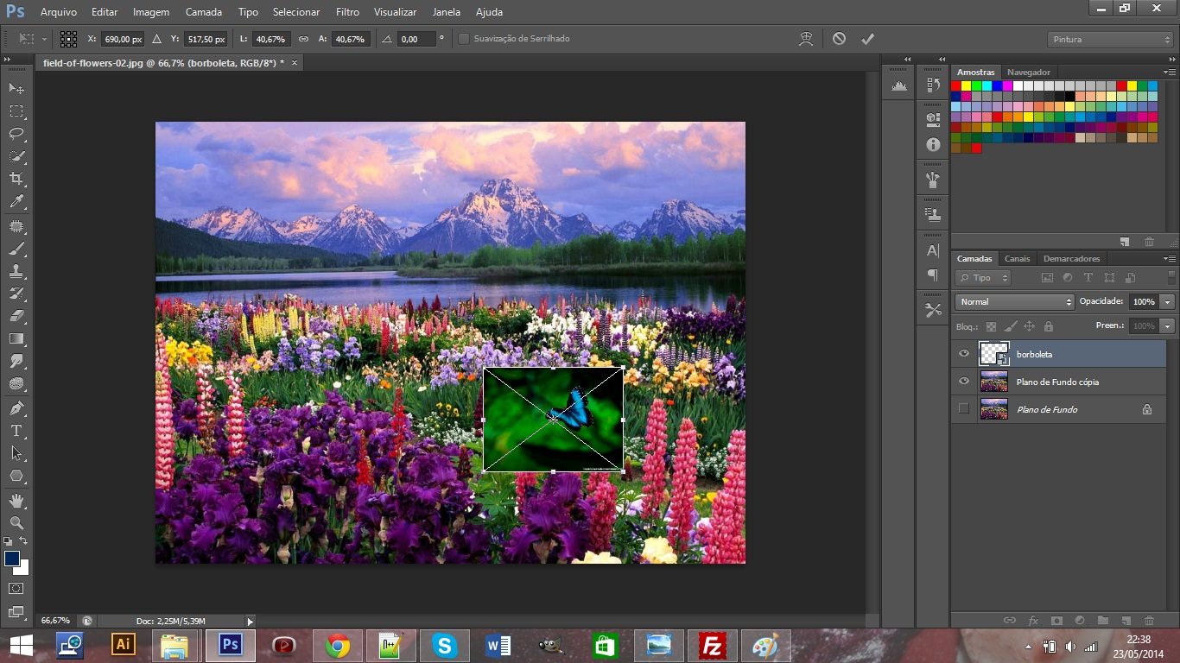

Slide 10
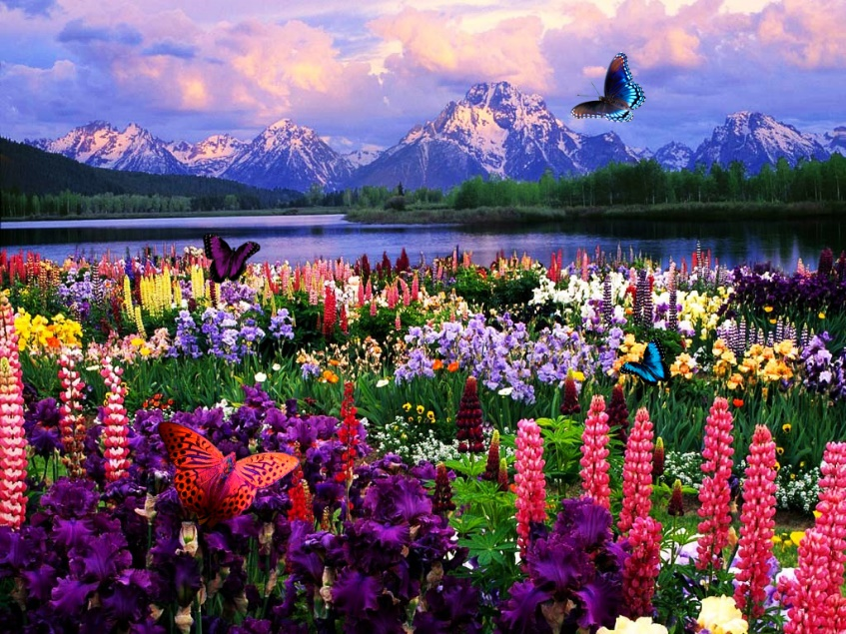
Antes
(Before)
Depois
(After)

